Slide 1
Application of a Structural Equation Model to Data from the Midlife in the United States Study (MIDUS)

Slide 2
Project Aim
To understand the effect of personality types on negative affect
Dependent variable: negative affect
Independent variable: personality

Slide 3
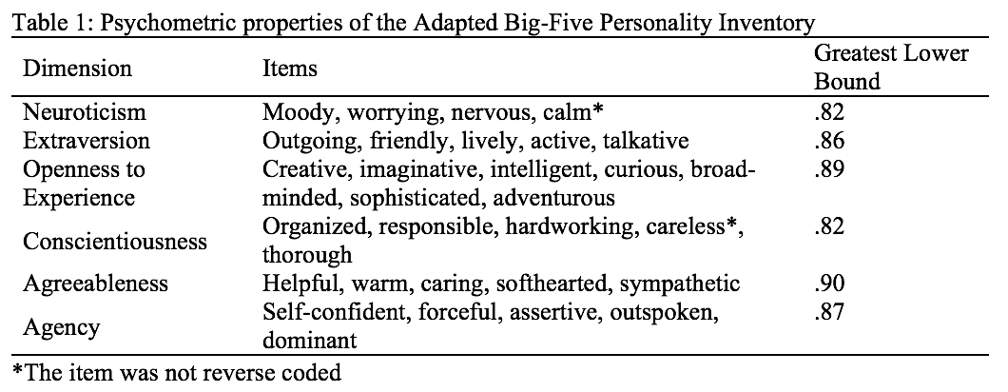
Personality Data
Data come from the Midlife in the United States Study
The Adapted Big-five Personality Inventory was used to assess six personality dimensions (neuroticism, extraversion, openness to experience, conscientiousness, agreeableness agency)
31 Likert-type items with response options ranging from 1-4
See Table 1 for the reliability (greatest lower bound) of this scale

Slide 4
Negative Affect Data
Data come from the Midlife in the United States Study
The negative affect scale used consists of 6 Likert-type items with response options ranging from 1-5
The reliability (greatest lower bound) for this scale was 0.89

Slide 5
Categorical Data Handling
The 31 personality items were treated as categorical since there are only 4 response options
The 6 negative affect items were treated as continuous since there are more than 5 response options
Justification: Johnson & Creech (1983)

Slide 6
Estimation
Parameter estimates were obtained using Bayesian estimation with two MCMC chains for faster computation
Non-informative priors were specified so that the Bayesian estimates would be similar to what would have been obtained with maximum likelihood had maximum likelihood been feasible
Maximum likelihood was not feasible due to the immense computational demand of producing estimates for categorical outcome variables and a large number of latent variables

Slide 7
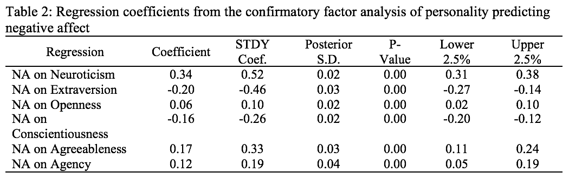
Results
A one-unit increase in neuroticism corresponds to a statistically significant 0.34 unit increase in negative affect, ceteris paribus (p < .0001)
A one-unit increase in extraversion corresponds to a statistically significant 0.20 unit decrease in negative affect, ceteris paribus (p < .0001)
A one-unit increase in openness corresponds to a statistically significant 0.06 unit increase in negative affect, ceteris paribus (p < .0001)
A one-unit increase in conscientiousness corresponds to a statistically significant 0.16 unit decrease in negative affect, ceteris paribus (p < .0001)
A one-unit increase in agreeableness corresponds to a statistically significant 0.17 unit increase in negative affect, ceteris paribus (p < .0001)
A one-unit increase in agency corresponds to a statistically significant 0.12 unit increase in negative affect, ceteris paribus (p < .0001)

Slide 8
Software
R was used to calculate reliability for the personality and affect scales
Mplus version 8.3 was used to fit the Bayesian structural equation models

Slide 9
References
Johnson, D. R., & Creech, J. C. (1983). Ordinal measures in multiple indicator models: A simulation study of categorization error. American Sociological Review, 398-407.
Leonardo Grilli & Carla Rampichini (2007) Multilevel Factor Models for Ordinal Variables, Structural Equation Modeling, 14:1, 1-25.
McNeish, D. (2018). Thanks coefficient alpha, we’ll take it from here. Psychological Methods, 23(3), 412-433.
Ryff, C., Almeida, D. M., Ayanian, J. S., Carr, D. S., Cleary, P. D., Coe, C., ... & Mroczek, D. K. (2007). National survey of midlife development in the United States (MIDUS II), 2004-2006.
Trizano-Hermosilla, I., & Alvarado, J. M. (2016). Best alternatives to Cronbach's alpha reliability in realistic conditions: congeneric and asymmetrical measurements. Frontiers in psychology, 7, 769.

